Slide 1


ForYou
Self care App for School and College students
Problem code: KH1150
Team Name:
Tech Junkies
Powered by NCERT and DoSEL

Slide 2
Overview of App
An App to ensure self-care at your fingertips
PREPARATORY LEVEL
(3rd - 5th class)
FOUNDATION LEVEL
(Nursery - 2nd class)
Good Touch & Bad Touch
Menstrual Awareness
Personalised Todo list
Gratitude Section
Fight your fears
Good Touch & Bad Touch
Bully Detection
Gratitude Section
SECONDARY + UNIVERSITY LEVEL
(9th onwards )
MIDDLE LEVEL
(6th - 8th class)
Depression Detection
Menstrual Tracker
Recommended activities
Sleep tracker
Add Personal To-Do List
Depression Detection
Menstrual Tracker
Recommended activities
Sleep tracker

Slide 3
Dynamic features of the App
Bully and Depression Detection
Sleep Tracker
Calorie Counter
Nowcast
General Conversation, recommendations using chatbot
Real-time Data Used
Step counter

Slide 4
Questionnaires Used for
Self- Care Activities
Good Touch and Bad Touch Detection (social & mental well being)
Depression Detection (mental well being)
Bully Detection (physical & mental well being)
Sleep Hygiene (Physical well being)

Slide 5
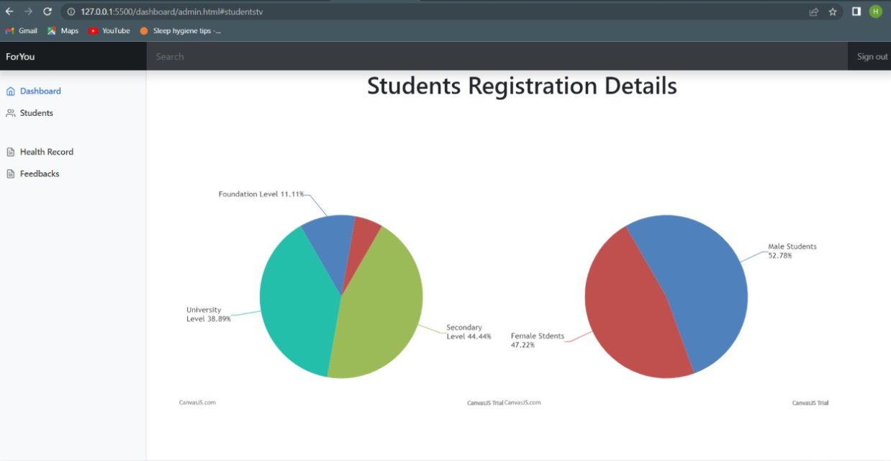
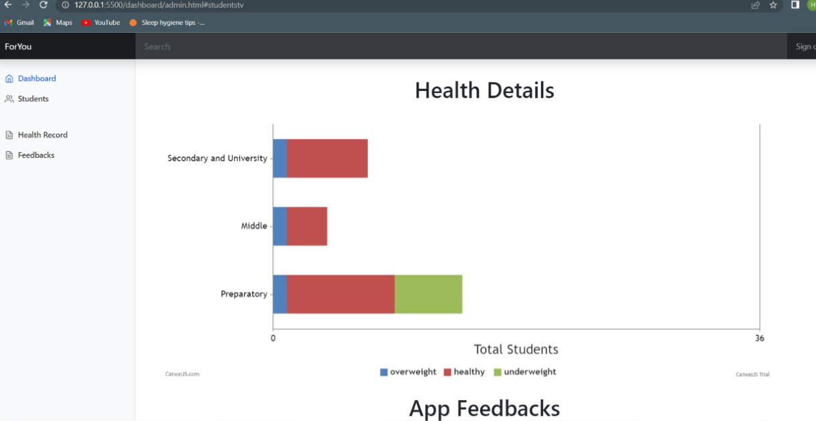
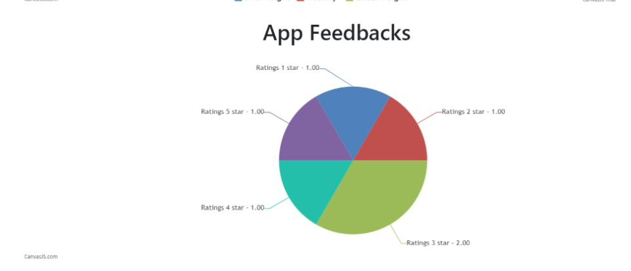
Admin Panel Support
Admin panel consists of following features: (web based)
Student/User Registration Data
Student Health Statistics
App feedback

Slide 6
Two Use Cases Of our App

Slide 7
Bully Detection: Use Case 1
Questionnaire presented to student when he or she is feeling sad
On the basis of responses, the app will detect whether the student was bullied or not
If bullying is detected based on questionnaire, parent of the student will be informed
Parents will be informed via separate login section for Parents

Slide 8
Sleep Tracker : Use Case 2
Record Sleep experience of student on daily basis.
Sleep score is maintained based on weekly basis.
If average sleep score is below a threshold, student needs to fill a questionnaire about sleep hygiene.
Based on the responses collected, recommendations for good sleep is generated.

Slide 9
Security Features in App
OAuth2 for saving passwords in Firebase
Store confidential data using Hashing Algorithm BlowFish
API key for project authorization and identification

Slide 10
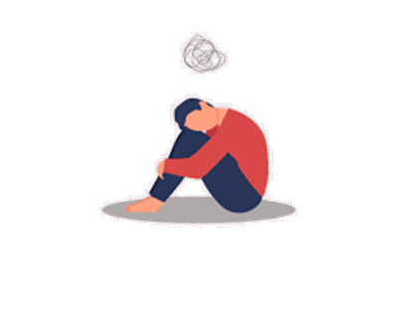
Depression Detection through Questionnaire
A UNICEF research on mental health has shown that 1 out of 7 teenagers suffer from depression. Effects of depression range widely from mild to very severe. It is necessary to detect and treat depression at initial stage.
This feature aims at detecting depression among teenagers using PHQ-9 questionnaire, and if detected therapists are recommended accordingly.

Slide 11
Counsellor Service Feature
Student can contact counsellor. If he/she has any mental issues.
Counsellor details are shared with students, if it is detected that student might be suffering from depression.
Rewards received from to-do list can be used to have conversation with counsellors.

Slide 12
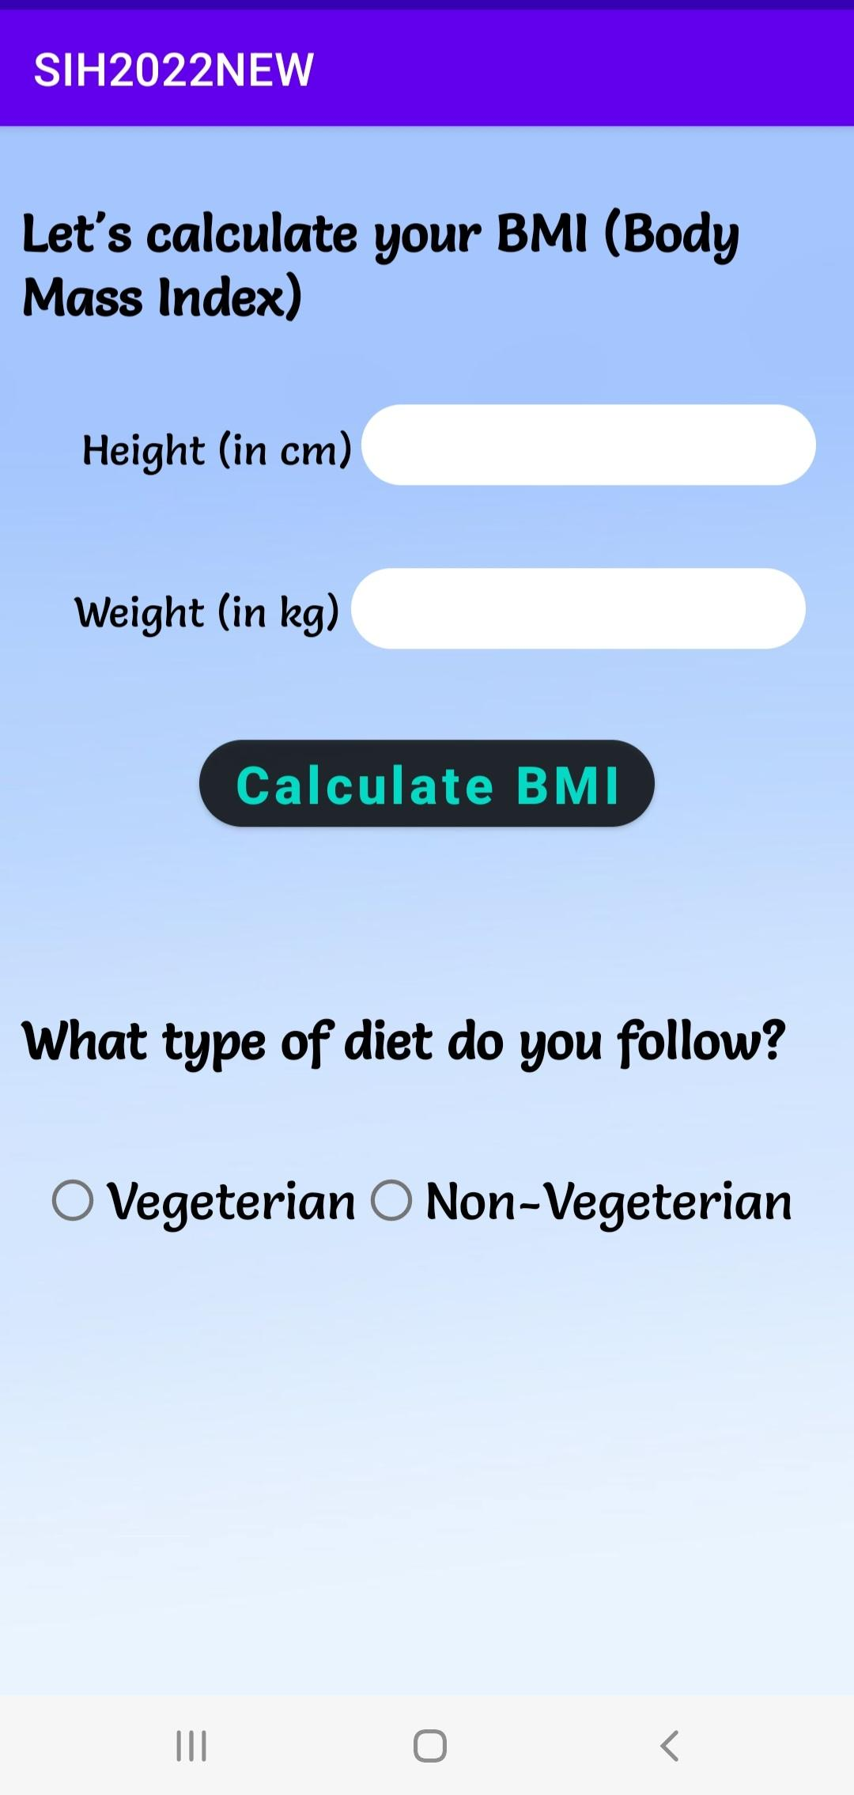
BMI Calculation & Diet Recommendation
Height, Weight and diet type of student is taken as input in order to calculate BMI, as diet and exercise will be recommended to every student based on their BMI.

Slide 13
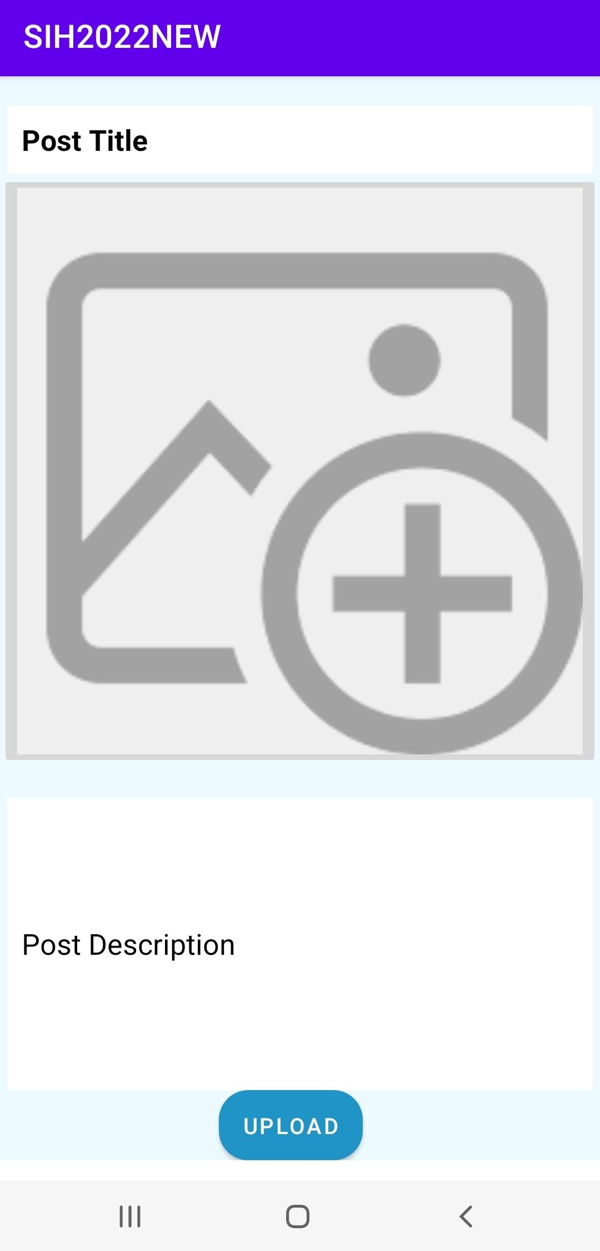
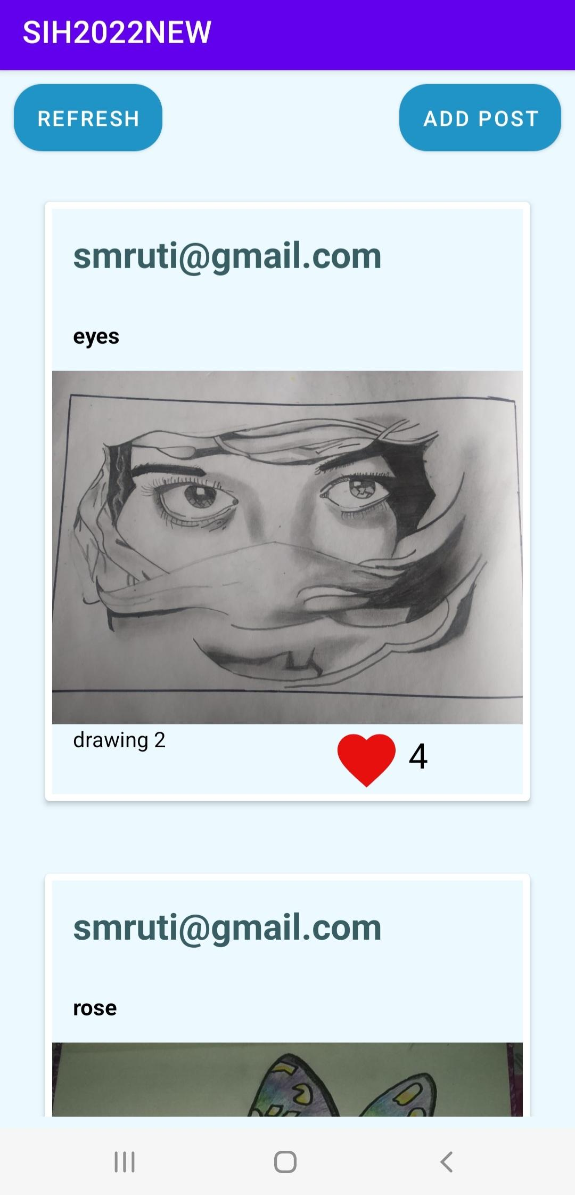
Features to achieve social self-care
NowCast
(For all age groups)
It is known that appreciation acts as a motivation and helps to build self confidence, Therefore this section has been added, where students can post their hobbies and self care activities.
This feature covers Social self care.

Slide 14
Chatbot
(foundation + preparatory level)
Middle to University level
Chatbot named Kiki is used to take user responses
on the basis of questions asked.
Objectives of chatbot are:
To provide recommendations on activities.
To take feedback regarding features of the app.
If feedback is positive, similar activities will be recommended.
Chatbot for nursery to 5th standard is option driven.
Activities would be suggested through chatbot.
Chatbot is also used for bullying detection among student through a questionnaire , that result will be provided to the parent in their dashboard section.

Slide 15
Menstruation Tracker
In most cases, young girls are unaware of menstruation, and therefore it can be scary.
Studies have shown that even today, 71% of adolescent girls in India remain unaware of menstruation till they get their first period
It is very important that awareness about puberty and menstruation is spread among young girls.
Girls can also track their periods using a feature provided by the app.
Girls are made aware about do’s and don'ts and recommend exercise and diet during this period.

Slide 16
To-do List
(preparatory to university level)
To-do list is introduced to make sure self care is achieved in all three domains i.e. physical, mental and social domain and also to increase involvement and interests of students in self care activities.
The app also provides a weekly activity data, where track of all the activities done by the student in a week are kept.
The most trending activity among all students would also be recommended.
On completion of each self care activity in To-do list, students will receive points which can be used in order to talk to our therapists.

Slide 17
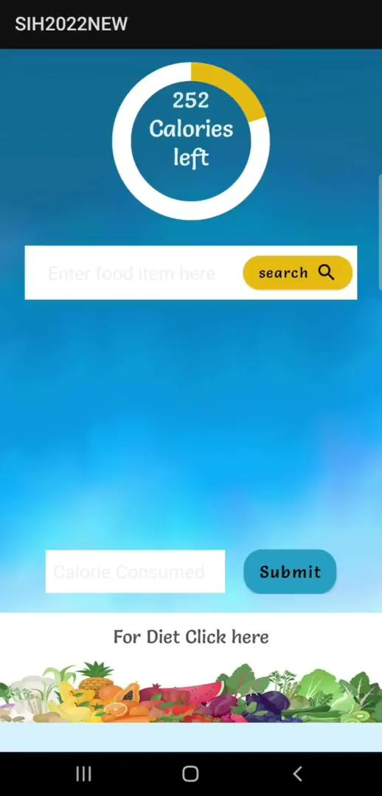
Features to achieve physical self-care
Calorie Counter
This feature is added in order to ensure that students are fulfilling their daily calorie requirements.
This feature ensures that the student’s physical Self Care is achieved.
On weekly basis we would provide the record of calorie in take to ensure proper nutrition intake.
3rd onwards

Slide 18
Future Work
Support for Divyaang Students
Using voice and text to speech feature
Students will be provided with contact information of other students with similar disabilities.
In order to promote physical activities for student’s well being, information of student highly active in that particular activity living in nearby locality will be shared.
An SOS facility will be provided for multiple purposes like student is in danger, so registered contact (parents or police) will be notified.
Adaptive and localization of Chatbot

Slide 19
References
Google survey for students of class 5th & above regarding activities on self care, https://docs.google.com/forms/d/1-AaQwtC9gL1O4 Y_-YoKcvyqbQL_-W2f6K wn-KHFwXE8/edit
Questionnaire and better understanding of depression detection,
https://www.verywellmind.com/depression-tests-mood-disorder-4174922
Animated videos and material for rhymes and stories,https://ncert.nic.in/healthandwell.php
knowledge on menstruation and puberty,https://www.gage.odi.org/ wp-content/uploads/2018/ 12/Menstruation-RER-WE B.pdf

Slide 20
THANK-YOU!
Tech-Junkies :)
TEAM MEMBERS
Aakanksha Trivedi (Team Leader)
Deepak Patil
Harsh Farkiya
Smruti Lakhamapurkar
Suhani Verma
Utsav Mandhani

Slide 21
Questionnaire for Depression Detection
Little interest or pleasure in doing things?
Feeling down, depressed, or hopeless?
Trouble falling or staying asleep, or sleeping too much?
Feeling tired or having little energy?
Poor appetite or overeating?
Feeling bad about yourself - or that you are a failure or have let yourself or your family down?
Trouble concentrating on things, such as reading the newspaper or watching television?
Moving or speaking so slowly that other people could have noticed? Or the opposite - being s fidgety or restless that you have been moving around a lot more than usual?
Thoughts that you would be better off dead, or of hurting yourself in some way?
Back

Slide 22
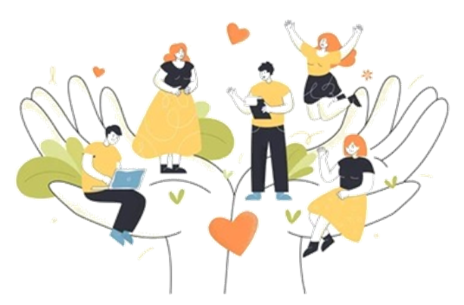
Social well being
Features to achieve social self-care
This feature is added in order to ensure Social well being of the students.
The students having similar interests in activities could connect together.

Slide 23
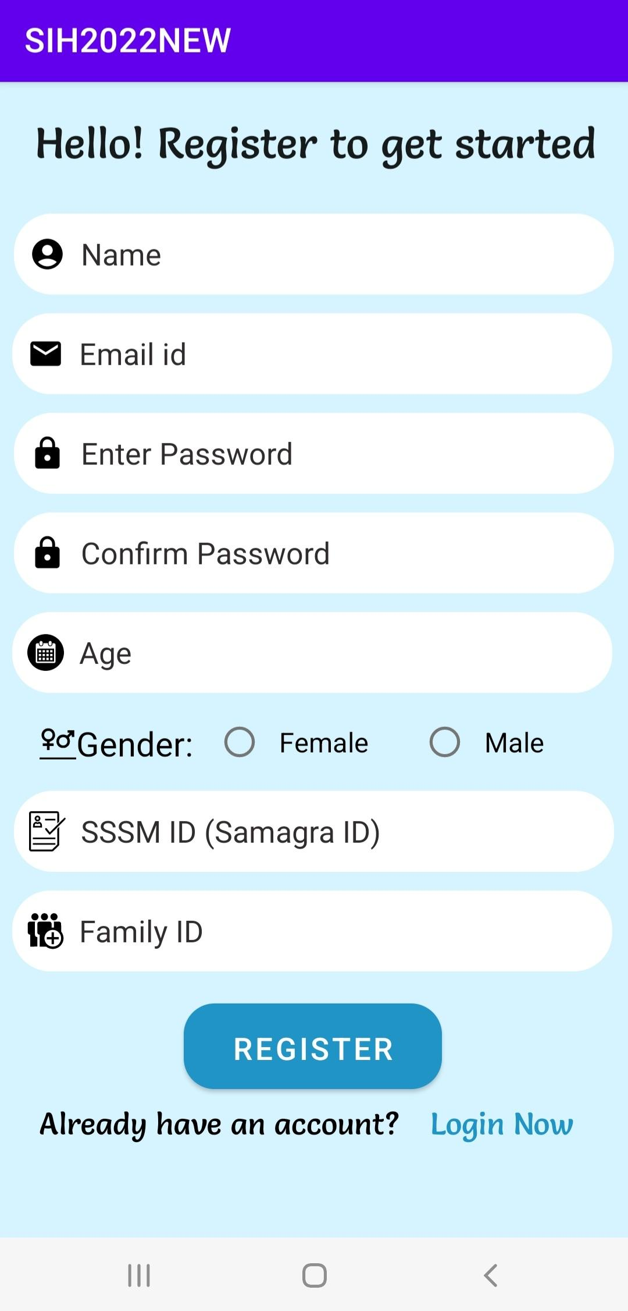
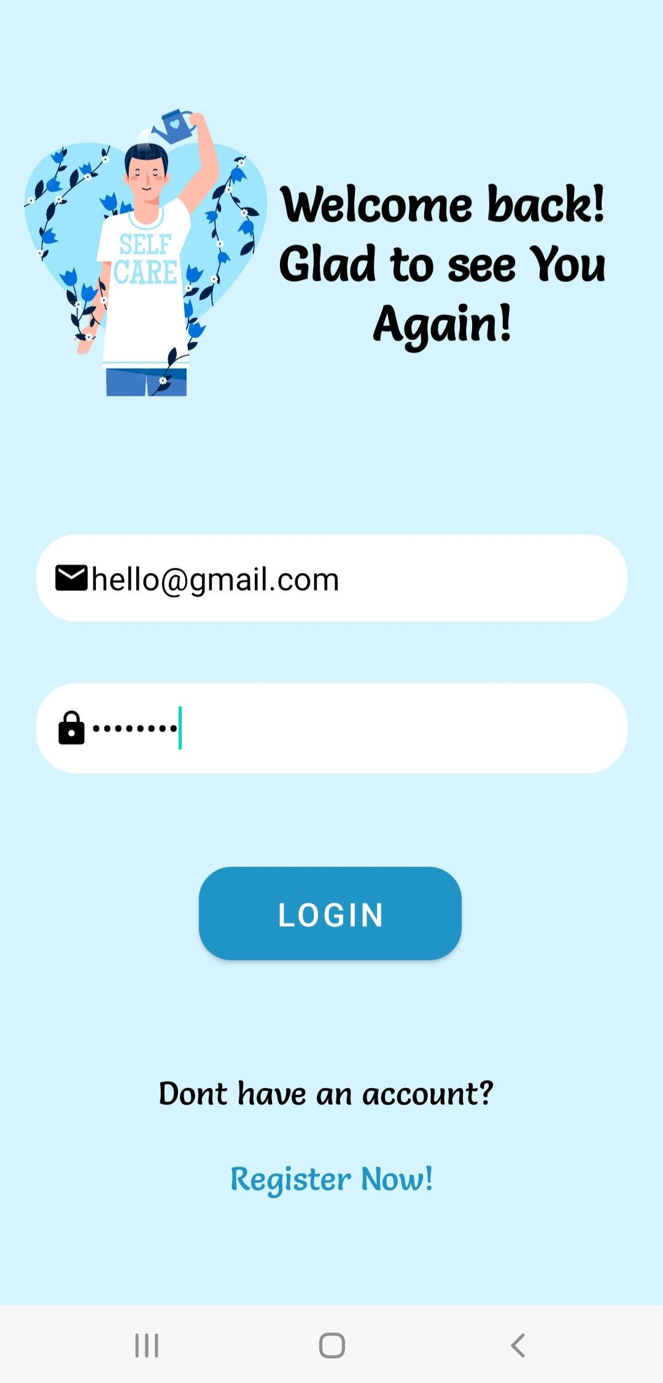
Register
Login
While registration, student needs to enter
following details which includes age, sssm id etc.
Young students can register with the help of their parents.
Gender will be used to provide features in our app that are gender specific.
Since our app consists of different features for students in different age groups, age of student is required.

Slide 24
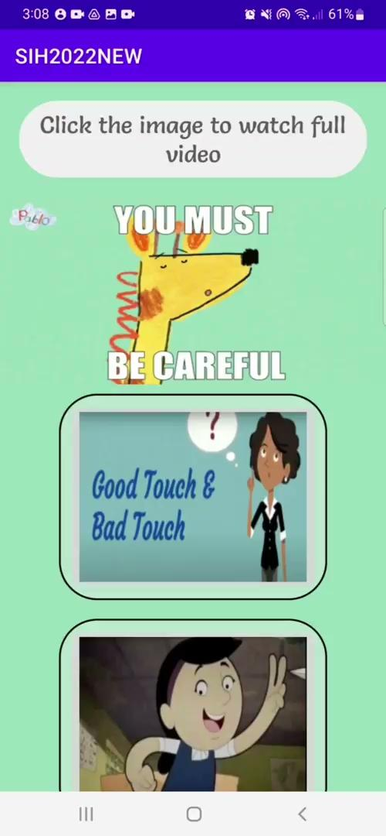

Features to achieve mental self-care
Good Touch &
Bad Touch
National Commision for Protection of Child Rights identified that 1 in every 10 children is sexually abused at least once under the age of 18.
It is essential for kids to understand Good & bad touches as cases of harassments are increasing dramatically especially in kids.
At the end of the informative video, a pop up quiz containing questionnaire will appear in order to identify child molestation and if identified parents will be informed about the same.
Nursery to 2nd
3rd to 5th

Slide 25
Features to achieve mental self-care
Therapist
It is essential that young children learn to regulate their feelings and understand their own behavior, in order to have more control over their life.
Teenagers are more prone to mental health issues such as anxiety, depression. It is very important to provide them proper guidance at right time.
Our App aims at detecting bullying or depression detection using chatbot, and suggests therapists to students.
Rewards can be used to contact the therapist.
6th onwards

Slide 26
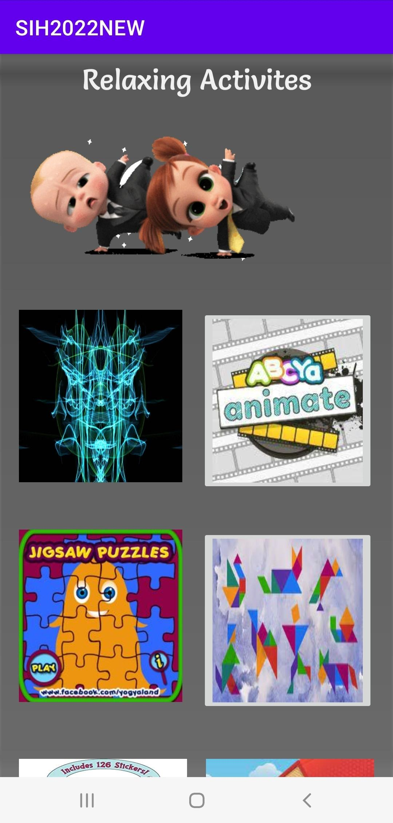
Features to achieve mental self-care
Fight your Fears
Relaxing Activities
It is usually found that fears of childhood lay a huge impact in future life. So it is highly essential for students to fight those fears in young age.
And as fears are nothing but games of mind, this section has been introduced to encourage students to conquer their fears.
A child’s mind is fragile and still-developing and is less suited to handle stress and negative emotions.
It can affect children’s performance in school, their interaction with adults and peers, and the way they perceive themselves.
So this section has been provided in order to help students relax.
Nursery to 5th
Nursery to 5th

Slide 27
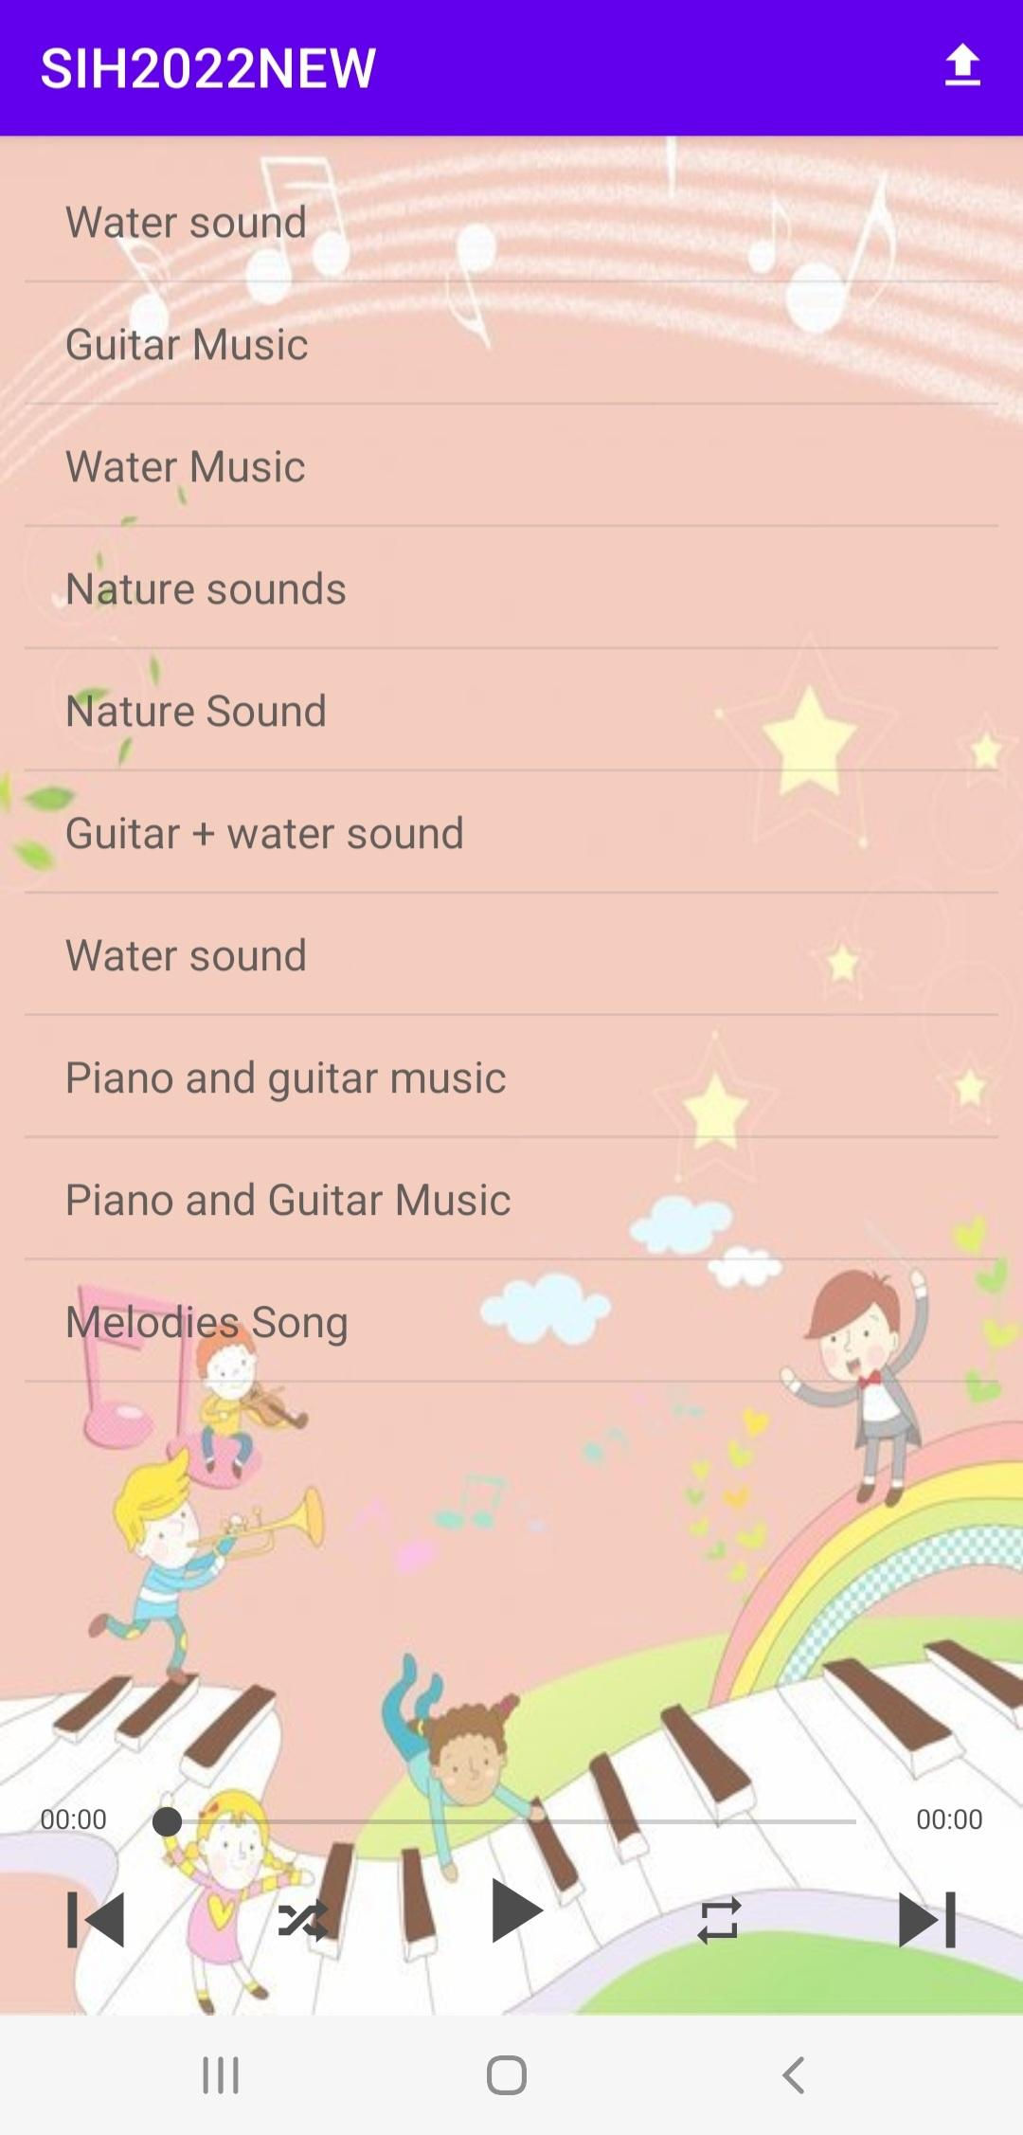
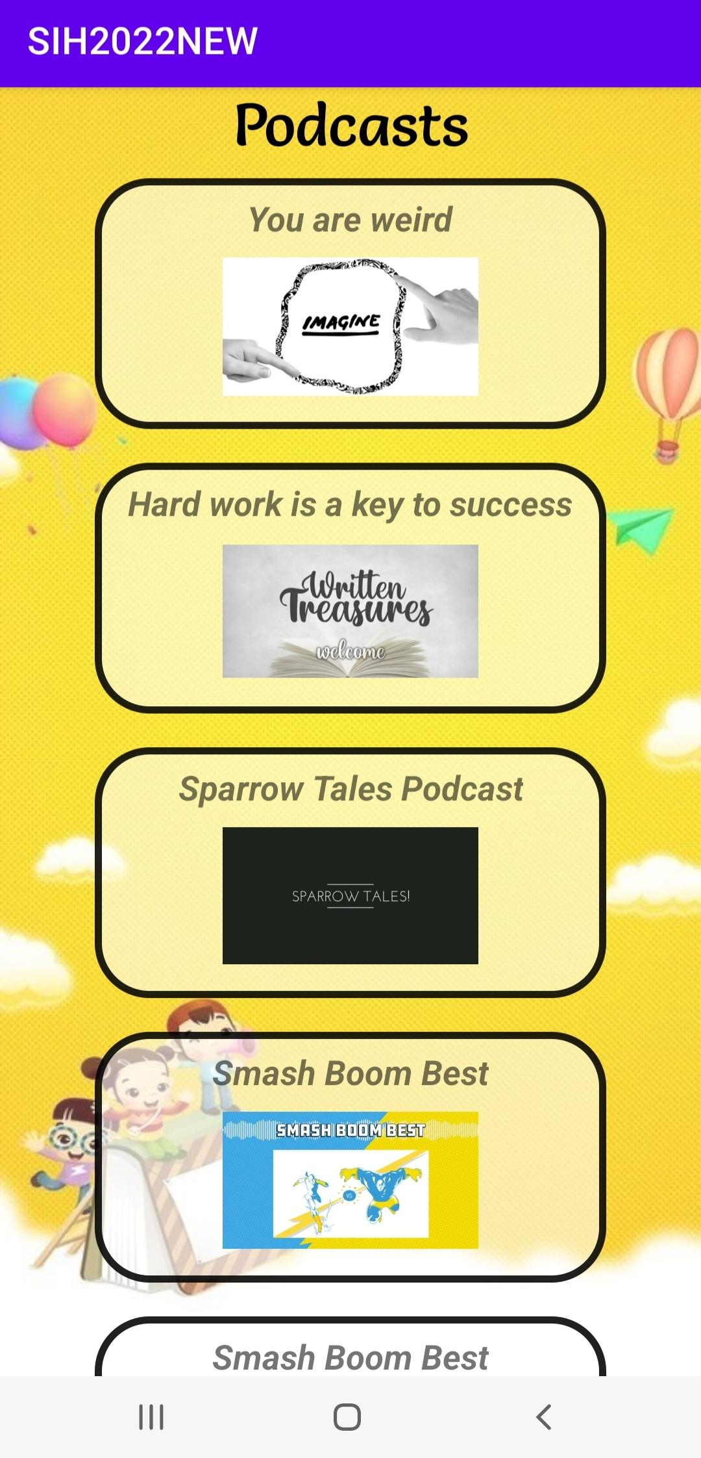
Music
Podcast
Music is also proven to provide lots of benefits, including relaxation, decreased anxiety, increased self-awareness and mindfulness.
Some soothing music is provided in the app via firebase
Podcasts are added in our app that will inspire kids and help to build their confidence
3rd onwards
3rd to 5th

Slide 28
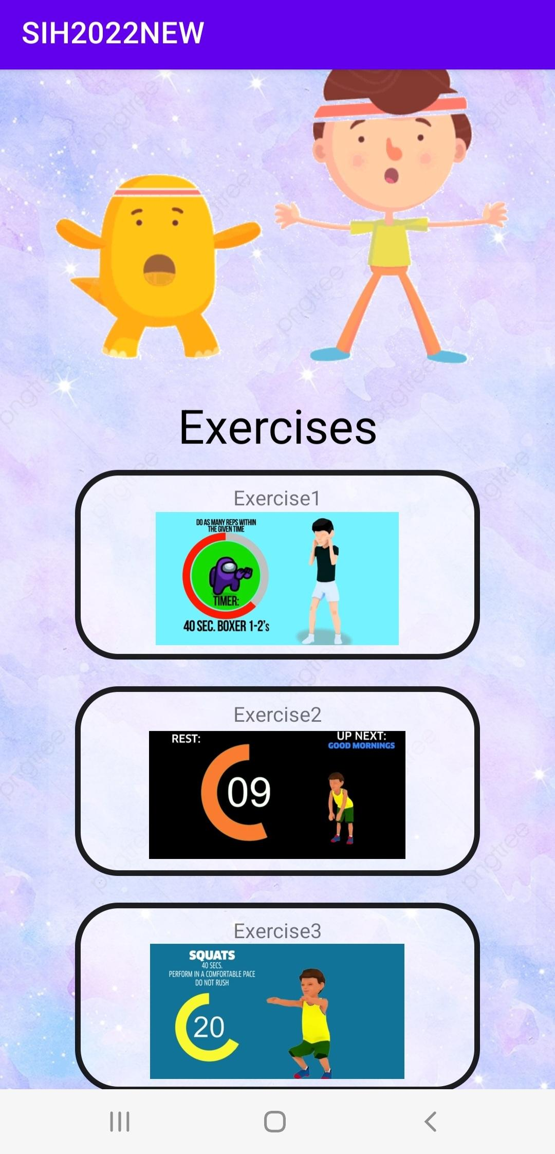
Features to achieve physical self-care
Exercise
Health
Evidences show that exercising regularly helps in reducing risks of chronic diseases as well as helps to boost confidence and mood.
Because of modern lifestyle, young students are at high risk of developing such conditions.
Exercise section is added in order to maintain the physical health of students of different age groups.
Information about health and its related issues should be spread among students at an early age to make them aware about diseases around them.
3rd to 5th

Slide 29
Features to achieve social self-care
We Time
Students these days suffer with lots of mental health issues like social anxiety which makes them introvert and this causes bad impact on both, their personal life as well future professional life.
These issues are most likely to occur because students are way too involved in themselves and prefer solitude.
To help students overcome these issues, we time section has been added.
This section encourages students to spend more time around people they love (family and friends) this is how we could achieve social self-care.
Nursery to 5th

Slide 30
Dashboard for Students
Gratitude Section
Different Dashboards are designed that consists of various features for different age group students that consist of all the features of our app
The purpose of this section is to lessen the feeling of constant comparison among students and this is achieved by adding gratitude towards life quotes, moral values and general information about self care.

Slide 31
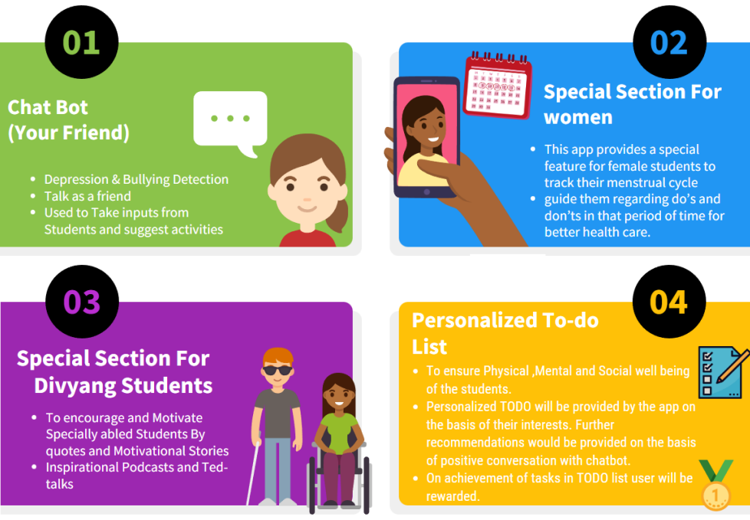
Main Features of App
03

Slide 32
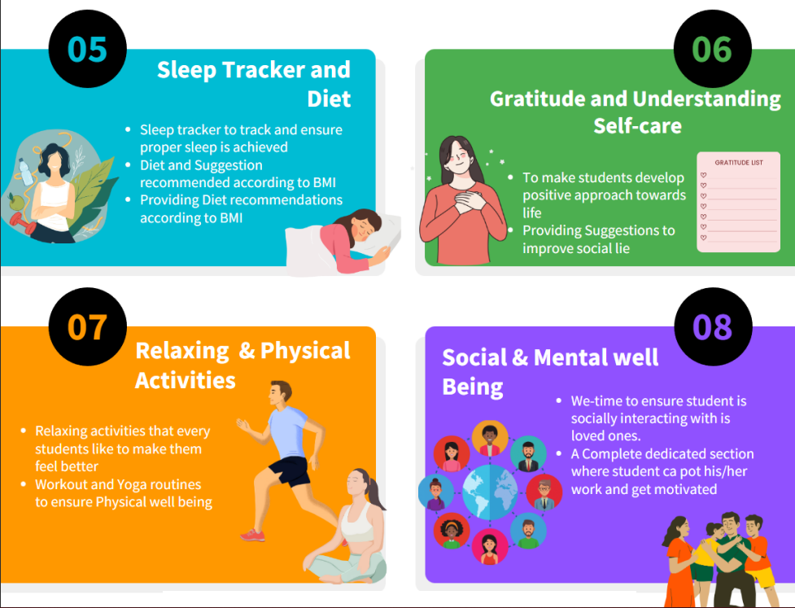
Features of App

